Slide 1
Lexical Analysis

Slide 2
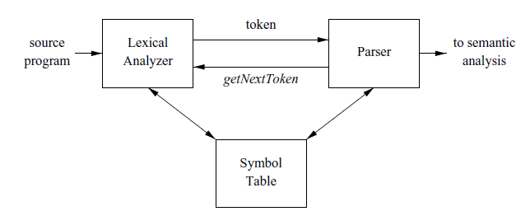
The Role of the Lexical Analyzer
Its main task is to read the input characters and produce as output a sequence of tokens that the parser uses for syntax analysis.

Slide 3
The Role of the Lexical Analyzer
Lexical Analyzer stripping out comments and whitespace (blank, newline, tab, and perhaps other characters that are used to separate tokens in the input).
Another task is correlating error messages generated by the compiler with the source program.
The lexical analyzer may keep track of the number of newline characters seen, so it can associate a line number with each error message.
In some compilers, the lexical analyzer makes a copy of the source program with the error messages inserted at the appropriate positions.
If the source program uses a macro-preprocessor, the expansion of macros may also be performed by the lexical analyzer.

Slide 4
Issues in Lexical Analysis
Why the analysis portion of a compiler is normally separated into lexical analysis and parsing (syntax analysis) phases??
Simplicity of design is the most important consideration.
Compiler efficiency is improved.
Compiler portability is enhanced.

Slide 5
Tokens, Patterns, Lexemes
In most programming languages, the following constructs are treated as tokens:
key words, operators, identifiers, constants, literal strings, and punctuation symbols such as parentheses, commas, and semicolons.
Pattern is a rule describing the set of lexeme that can represent a particular token in source programs.
A lexeme is a sequence of characters in the source program that matches the pattern for a token and is identified by the lexical analyzer as an instance of that token.

Slide 6
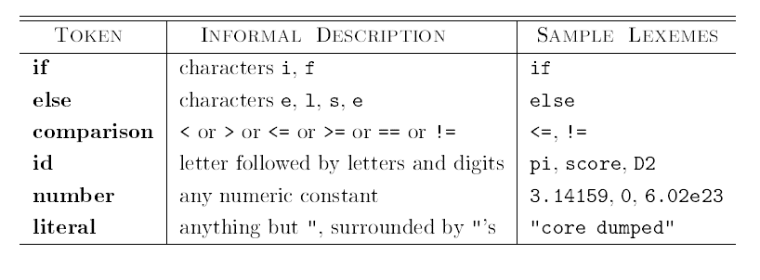
Tokens, Patterns, Lexemes

Slide 7
Attributes for Tokens
When more than one lexeme can match a pattern, the lexical analyzer must provide the subsequent compiler phases additional information about the particular lexeme that matched.
For example, the pattern for token number matches both 0 and 1, but it is extremely important for the code generator to know which lexeme was found in the source program.
Thus, in many cases the lexical analyzer returns to the parser not only a token name, but an attribute value that describes the lexeme represented by the token;

Slide 8
The token names and associated attribute values for the Fortran statement
E = M * C ** 2 are written below as a sequence of pairs.
<id, pointer to symbol-table entry for E>
<assign op>
<id, pointer to symbol-table entry for M>
<mult op>
<id, pointer to symbol-table entry for C>
<exp op>
<number, integer value 2>
Note that in certain pairs, especially operators, punctuation, and keywords, there is no need for an attribute value.

Slide 9
Strings and Languages
An alphabet is any finite set of symbols. Typical examples of symbols are letters, digits, and punctuation. The set {0,1} is the binary alphabet. ASCII is an important example of an alphabet; it is used in many software systems.
A string over an alphabet is a finite sequence of symbols drawn from that alphabet.
In language theory, the terms “sentence” and “word” are often used as synonyms for “string.” The length of a string s, usually written as |s| is the number of occurrences of symbols in s. For example, banana is a string of length six. The empty string, denoted ε is the string of length zero.
A language is any countable set of strings over some fixed alphabet

Slide 10
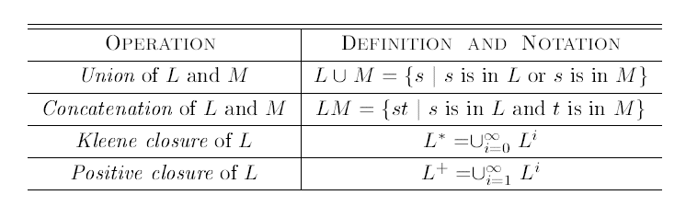
Operations on languages

Slide 11
languages that can be constructed from languages L and D, using the operators
1. L U D is the set of letters and digits
2. LD is the set of strings consisting of one letter followed by one digit.
3. L⁴ is the set of all 4-letter strings.
4. L* is the set of all strings of letters, including ε the empty string.
5. L(L UD)* is the set of all strings of letters and digits beginning with a letter.
6. D⁺ is the set of all strings of one or more digits.

Slide 12

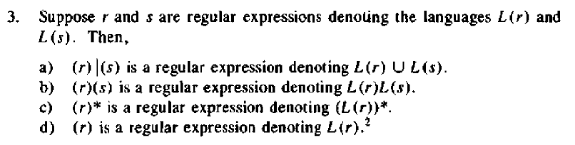
Regular Expressions

Slide 13

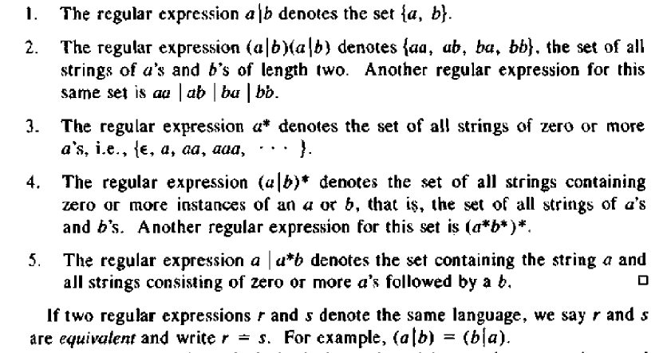
Regular Expressions

Slide 14
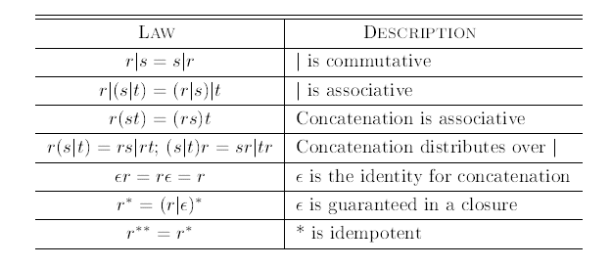
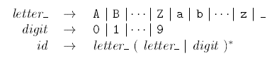
Algebraic laws for Regular Expression

Slide 15
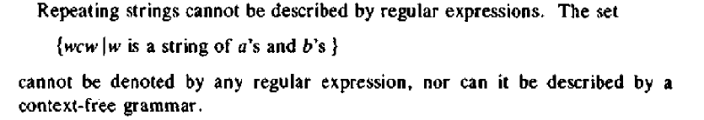
Non Regular Sets

Slide 16

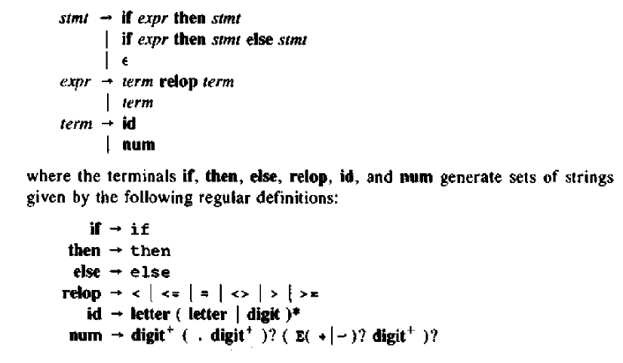
RECOGNITION OF TOKENS

Slide 17
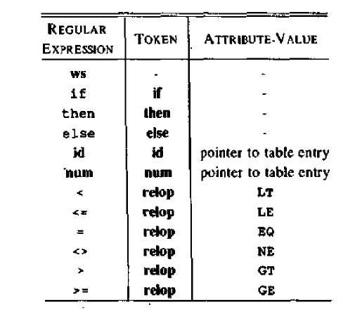

RECOGNITION OF TOKENS

Slide 18
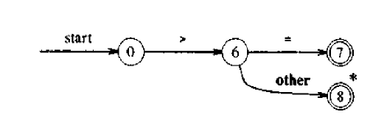

Transition Diagrams
Transition diagrams are used to keep track of information about characters that are seen as the forward pointer scans the input.
Positions in a transition diagram are drawn as circles and are called states. The states are connected by arrows, called edges.

Slide 19
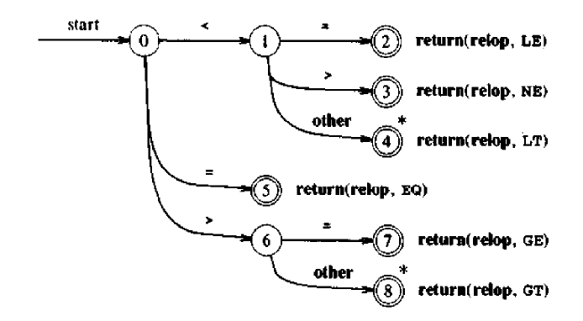

Transition Diagrams

Slide 20
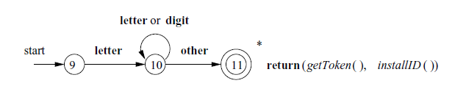

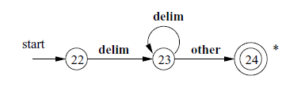


Slide 21
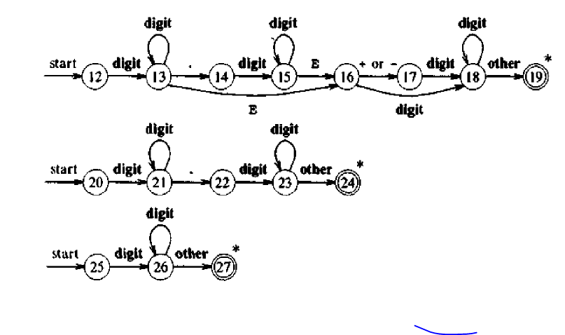
Transition diagrams for unsigned numbers

Slide 22
Finite Automata
Finite automata are recognizers; they simply say “yes” or “no” about each possible input string.
Finite automata come in two flavors:
(a) Nondeterministic Finite automata (NFA) have no restrictions on the labels of their edges. A symbol can label several edges out of the same state, and ε, the empty string, is a possible label.
(b) Deterministic finite automata (DFA) have, for each state, and for each symbol of its input alphabet exactly one edge with that symbol leaving that state.
Both deterministic and nondeterministic finite automata are capable of recognizing the same languages. I
In fact these languages are exactly the same languages, called the regular languages that regular expressions can describe.

Slide 23
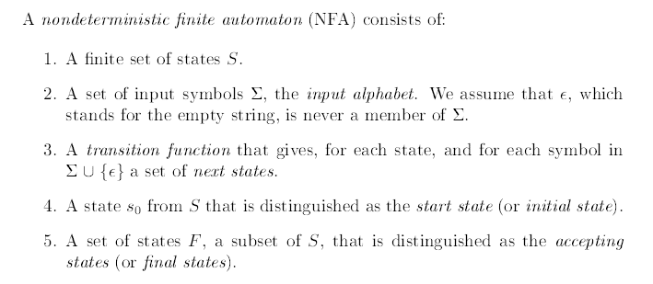
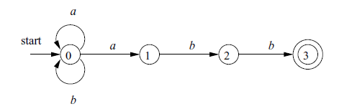
Nondeterministic Finite Automata

Slide 24
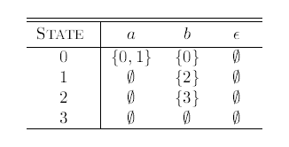
Transition table for the NFA

Slide 25

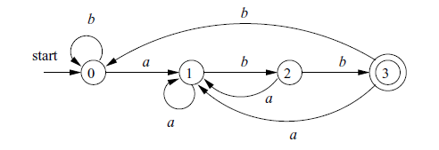

Deterministic Finite Automata

